Slide 1
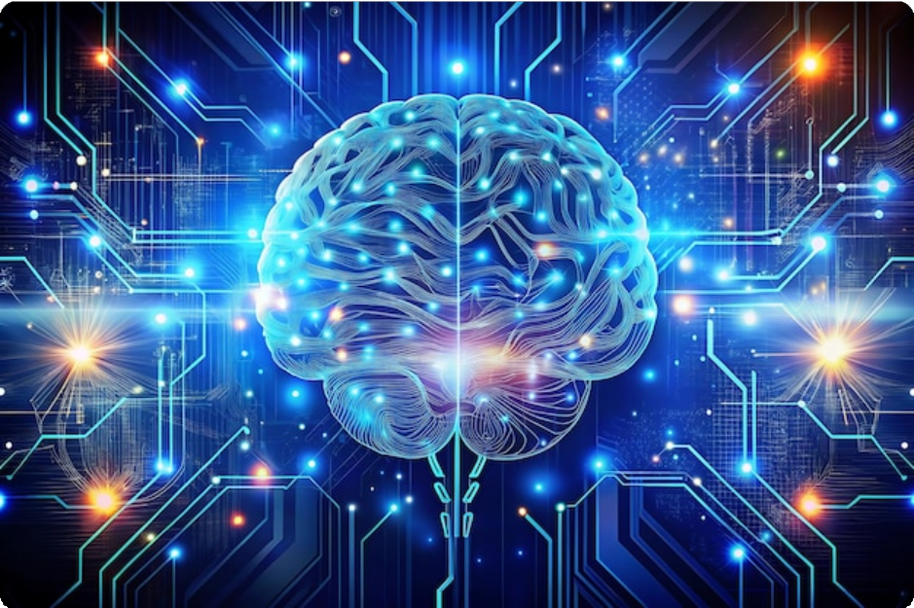
Introduction to Artificial Intelligence
Exploring the technology that enables computers and machines to simulate human intelligence

Slide 2





Learning Outcomes
Understanding what is AI and its fundamental concepts
Knowing the background and history of AI development
Understanding common types of AI and core technologies
Recognizing AI applications in different domains

Slide 3
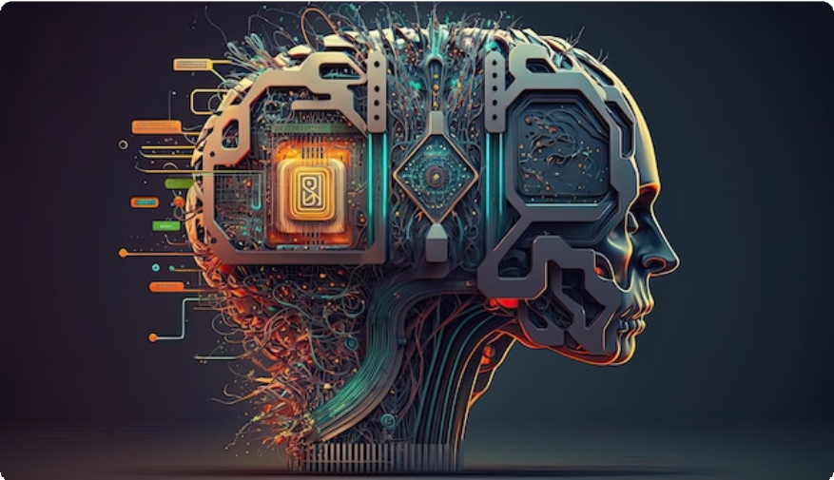



What is Artificial Intelligence?
AI is technology that enables computers and machines to simulate human intelligence.
AI is not a human, but can do human-like tasks to make daily life easier
AI works using data, just like a rocket works using fuel
AI uses algorithms to process data like humans use brain to perform tasks
AI has emerged as the new electricity of digital era

Slide 4










AI as the New Electricity
AI has emerged as the new electricity of digital era. As electricity changed the world over a century ago, AI is transforming every aspect of modern life.
Morning: Personalized smartphone notifications
Commute: AI-powered GPS navigation
Healthcare: Machine learning diagnoses
Finance: Intelligent fraud detection
Education: Recommendation engines
Personalized notifications
Voice assistants
Email spam filters
Shopping recommendations
"
The commoditization of AI means that its benefits are no longer confined to tech giants, but have democratized to become accessible tools that enhance human capability across all sectors of society.

Slide 5



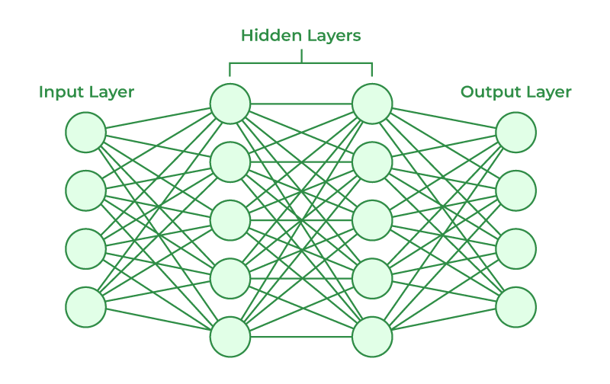


Core Technologies of AI
AI is one word, but it covers many technologies that enable computers to simulate human intelligence.
Machine Learning
Deep Learning
Algorithms that learn from data on their own, without human teaching them step by step
Subset of ML that uses neural networks. More powerful algorithms that solve complex problems
Natural Language Processing
Computer Vision
Makes computers understand and generate human language. Large language models like ChatGPT belong to this category
Deals with processing of images and videos, enabling machines to interpret visual information

Slide 6


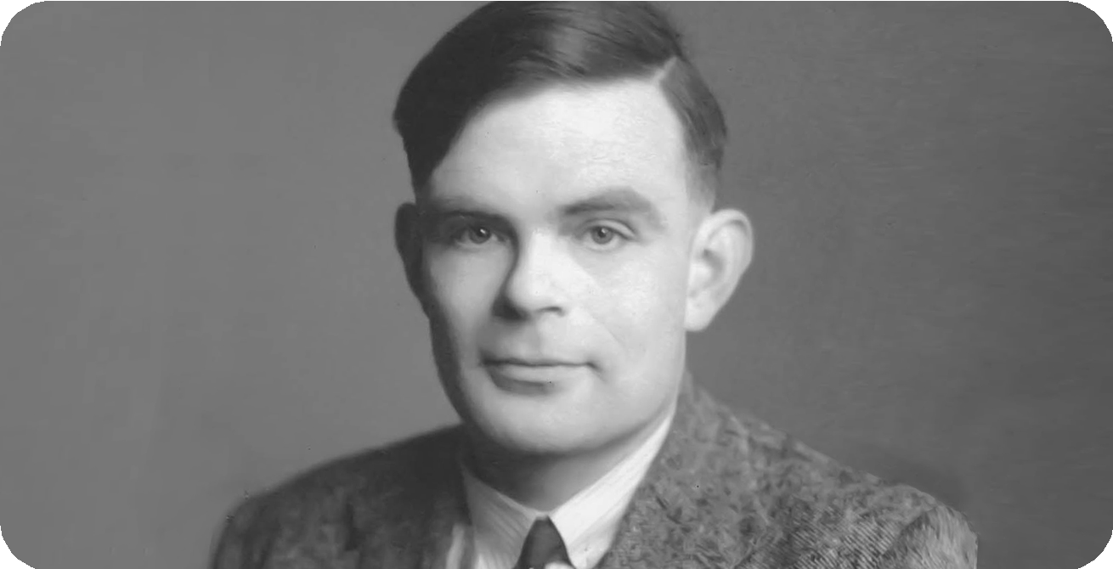




Brief History of AI
The history of AI is marked by distinct periods of innovation, setbacks, and breakthroughs.
Alan Turing: Father of AI
British mathematician and computer scientist
The Turing Machine
Theoretical model of computation that manipulates symbols on a strip of tape according to rules
Laid theoretical groundwork for modern computers
1936
Proposed the "Imitation Game" (Turing Test) to evaluate machine intelligence
The Turing Test
Proposed as a measure of a machine's ability to exhibit intelligent behavior
His work established the philosophical framework for AI research
1950
Dartmouth Conference
Birth of AI as a field, coining the term "Artificial Intelligence"
1956
ELIZA
Early natural language processing program that simulated conversation
1966

Slide 7


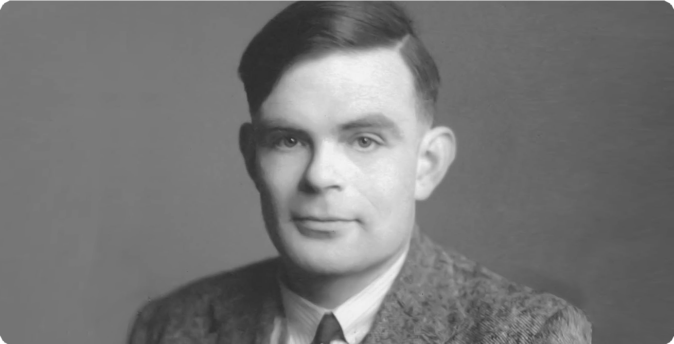












Alan Turing and the Turing Test
In 1950, Turing introduced the concept of the "imitation game", now known as the Turing Test, in his paper "Computing Machinery and Intelligence."
How the Turing Test Works
The process involves a human evaluator engaging in conversations with both a human and a machine without knowing which is which.
Interrogator asks questions through text interface Both human and machine respond
Interrogator tries to identify which is human
If machine cannot be reliably identified, it passes the test
Alan Turing (1912-1954), British mathematician and computer scientist
What is the Turing Test?
A method to determine if a computer can demonstrate human-like intelligence through natural language conversations.
Significance in AI Development
Benchmark for Intelligence: Provides a clear goal for AI researchers
Focus on Natural Language: Emphasizes importance of language in intelligence
Philosophical Framework: Offers approach to question "Can machines think?"
Turing predicted that by 2000, a computer would have a 30% chance of fooling a human after five minutes
Interrogator: Human judge
Human Participant
Machine: AI system
Text Interface

Slide 8

Quiz: AI Concepts
Test your knowledge of Artificial Intelligence concepts covered in this lecture.
1 Which of the following best defines Artificial Intelligence (AI)?
The study of human intelligence and its applications. b) The simulation of human intelligence in machines.
c) A branch of computer science focused on developing games.
_{d)} The process of automating repetitive tasks using simple
algorithms.
Correct Answer: b) The simulation of human intelligence in machines that are programmed to think like humans and mimic their actions.
Explanation: AI refers to the simulation of human intelligence in machines, including learning, reasoning, problem-solving, perception, and language understanding.
2
Who is considered the father of Artificial Intelligence?
a) Marvin Minsky
b) John McCarthy
c) Alan Turing
d) Herbert Simon
Correct Answer: c) Alan Turing
Explanation: The Turing Test was proposed by British mathematician and computer scientist Alan Turing in his 1950 paper, "Computing Machinery and Intelligence." He originally called it the "Imitation Game."
3 Which of the following is considered an early example or precursor to AI concepts?
Deep Blue defeating Garry Kasparov in chess (1997) b) ELIZA, an early natural language processing program (1966)
c) AlphaGo defeating Lee Sedol in Go (2016) d) Self-driving cars becoming commercially available (2020s) Correct Answer: b) ELIZA, an early natural language processing computer program (1966)
Explanation: ELIZA, developed at MIT in 1966, was one of the earliest programs capable of processing natural language. It simulated a Rogerian psychotherapist by rephrasing user input as questions, demonstrating early AI capabilities in human-computer interaction.

